Slide 1
Interoperability
Source of some materials:
Xiwei Xu, Ingo Weber, and Mark Staples. Architecture for Blockchain Applications. Springer, 2019

Slide 2
Outline
Interoperability & standards
Blockchain interoperability
Notary schemes, oracles, slidechains, atomic swap, blockchain of blockchains
Layer 2 mechanisms
State channels, Rollups, & Plasma
Notes:
We will first start with definitions on interoperability and standards for interoperability.
Then we discuss a selected set of blockchain interoperability techniques like notary schemes, oracles, slidechains, atomic swap, blockchain of blockchains.
Finally, we’ll have an overview of Layer 2 mechanisms like State channels, Rollups, and Plasma.

Slide 3
Interoperability & Standards

Slide 4
Interoperability
Ability of 2 systems to work together
Lack of it leads to fragmentation, vendor lock-in, risk of obsolescence, …
Degree to which 2 or more systems, products, or components can exchange information & use information that has been exchanged – ISO/IEC 25010:2011
Challenging due to
Semantic differences
Diversity of data representations, software, systems, & networks
Too many integration points
At most n(n – 1)/2 connections for n nodes
Notes:
Interoperability is the ability of 2 software or systems to work together.
Lack of interoperability leads to fragmentation, vendor lock-in, risk of obsolescence, and lack of standards.
More formally, ISO/IEC 25010:2011 standard defines it as the degree to which 2 or more systems, products, or components can exchange information & use the information that has been exchanged. This focuses on 2 aspects:
Ability exchange data
Ability to use that data
Interoperability in information systems is quite challenging due to several factors.
2 systems to integrate may be conceptually different. E.g., one system may represent users using their user name and another may assign a unique number.
Data representations – 2 systems may store the same data in different formats both at the software and hardware level, e.g., representation of dates and floating point numbers.
Software – 2 software trying to talk to each other may be developed in different programming languages, representation of strings and arrays are usually different.
Systems – One system may run Windows while the other runs Linux
Networks – One would use a wired network while the other may use wireless or use different network protocol versions, e.g., one use TLS version 1.0 and the other 1.2
No of the integration points has a quadratic growth (i.e., n^2) compared to the number of systems/services to integrate. See animation. With 10 blockchains, we need 45 integrations.

Slide 5
Interoperability (Cont.)
Needs to happen at different levels
Inter-organisation coordination, i.e., consensus to work together
Business process integration, i.e., unified business process
Semantic application integration, i.e., means the same thing
Syntactic application integration, i.e., ability to map from one to another
Physical integration, i.e., actual connectivity
Interoperability is domain-specific
Level 1 to 3 tend to be application & domain specific
Standardisation is key for widespread interoperability
Mostly technical & cover level 4 & 5
Notes:
Interoperability needs to happen at different levels, e.g.,
Inter-organisation coordination is essential to interoperate, where consensus needs to be reached on how to work together. Also, issues need to be resolved as they arise.
Business process integration is required to asynchronies and has a unified business process across all involved parties. However, this does not mean the same process needs to run everywhere, and different fragments can run in different places.
Semantic application integration is required to ensure all systems mean the same thing, e.g., a customer or an asset is uniquely identified.
Syntactic application integration does not require everyone to represent the data in the same way. Rather we need the ability to map from one data representation to another. E.g., conversion of units.
Physical integration is where the actual connectivity happens. This is also at different levels from software, and hardware to networks.
Interoperability is domain-specific. E.g., how interoperability is handled in supply chains will be different from financial markets or healthcare.
Level 1 to 3 above tends to be application specific. However, several aspects of integration can be discussed at the domain level.
Standardisation is key for widespread interoperability.
Most of the standards exist for levels 4 and 5 which include more technical aspects of integration.

Slide 6
Interoperability Standards
Many standards
ISO/IEC 10021-6:2003 Information technology – Message Handling Systems (MHS)
ISO/IEC 19941:2017 Information technology – Cloud computing — Interoperability and portability
ISO/IEC 40210:2011 Information technology – W3C SOAP Version 1.2 Part 1: Messaging Framework (2nd Edition)
ISO 20022-8:2013 Financial services – Universal financial industry message scheme
IEEE 2418.2-2020 – IEEE Standard for Data Format for Blockchain Systems
In development
ISO/TC 184/SC 5 – Interoperability, integration, and architectures for enterprise systems and automation applications
ISO/TC 307 – Blockchain and distributed ledger technologies technical committee
IEEE Computer Society Blockchain and Distributed Ledger Standards Committee
Notes:
There are many interoperability standards, and some of them covering different aspects are listed here.
The first one is generic, while the 2nd one is specific to cloud computing. 3rd one is very technical and focuses on a SOAP (Simple Object Access Protocol), a standard for web-based services
4th one is on messaging related to financial services. ASX CHESS+ will use this messaging standard
The last one is specifically on blockchain data formats
ISO/IEC 10021, Information Technology – Message Handling Systems (MHS) standard defines the overall system and service of an MHS and serves.
ISO/IEC 19941:2017 specifies cloud computing interoperability and portability types, the relationship, and interactions between these two cross-cutting aspects of cloud computing and common terminology and concepts used to discuss interoperability and portability, particularly relating to cloud services.
ISO 20022 is a standard for electronic data interchange between financial institutions. It describes a metadata repository containing descriptions of messages and business processes and a maintenance process for the repository content. It covers financial information transferred between financial institutions that includes payment transactions, securities trading, and settlement information, credit and debit card transactions and other financial information.
Several interoperability standards are in development, some of them specifically on blockchains.
ISO/TC 307 https://www.iso.org/committee/6266604/x/catalogue/p/0/u/1/w/0/d/0
ISO/WD TR 6277 - Blockchain and distributed ledger technologies – Data flow model for blockchain and DLT use cases
ISO/AWI TS 23516 - Blockchain and Distributed Ledger Technology — Interoperability Framework
IEEE CS TS https://sagroups.ieee.org/bdlsc/#1616054054487-9cb13c78-4c4a
P3204 - Standard for Blockchain Interoperability - Cross Chain Transaction Consistency Protocol
P3205 - IEEE Draft Standard for Blockchain Interoperability - Data Authentication and Communication Protocol

Slide 7
Blockchain Interoperability

Slide 8
Blockchain Interoperability
Ability of different blockchains to exchange data & move digital assets while maintaining state & uniqueness
Public-public, public-private, private-private; on-chain & off-chain
Single & multi-token TXs
Without interoperability
Blockchains are data/asset silos that fragment a market
Restricts composability limiting use cases & innovation
Challenging due to
Single source of truth
Differences in finality
Data embedded in smart contracts
Immutability vs rollbacks
TX, data, & account representations
Notes:
Blockchain interoperability refers to the ability of different blockchain networks to exchange and leverage data between one another, as well as to move digital assets between respective blockchains. In doing so we want to maintain the state and uniqueness of those data/assets.
Depending on the use cases, Interoperability could be between 2 public blockchains, a public and a private one, or 2 private ones.
It could involve a single token (e.g., an asset moving from one chain to another) or multiple tokens (e.g., swapping assets on 2 chains).
Interoperability between a BC and entities outside the BC is also sometimes considered under interoperability.
Without interoperability, blockchains are data/asset silos that fragment a market. It could also hinder users from benefiting from features offered by other platforms to compose applications with much greater benefits.
Achieving interoperability in blockchains is nontrivial and complicated by several factors, such as:
Blockchains are supposed to maintain a single source of truth. Hence, we can allow the same data/asset to be active on multiple blockchains. Hence, interoperability is more than copying data. Instead, when minting an asset on the target blockchain, it must be burned on the source blockchain.
Different consensus protocols lead to different forms of finality. Dealing with probabilistic finality is challenging as a transaction could be cancelled in the future.
Data embedded in smart contracts make it difficult to move data without explicit support from smart contracts.
Immutability and rollbacks don’t go together. Hence, the only option is to use a cancelling transaction. But for certain applications, it may be too late as the new asset owner may have already transferred it out.
Data and account representations make it difficult to map from one form to data to another or from one use to another. Also, the same transaction may not be able to include different forms of data, such as different signatures or address formats.

Slide 9
Cross-Chain Technology
Notary schemes
Oracles
Like notary schemes with source/target being off-chain
Slidechains & relays
Hash-Time Lock Contract (HLTC)
Blockchain of blockchains
Notes:
Blockchain interoperability solutions are known as cross-chain technologies. Here we list several major categories.
Notary schemes use a trusted notary to convey data between 2 blockchains to enable data/asset transfer.
Oracles are similar to notary schemes where data or assets transfer is between blockchain and off-chain components.
Sidechains are secondary blockchains that have a peg to the main chain. Relays are a special form of sidechain implementation where the relay is another blockchain that is used to record transactions/events from one blockchain and make it available to one or more other blockchains.
A Hash Time Lock Contract (HTLC) is an atomic transaction mechanism to swap assets across 2 or more blockchains.
Blockchain of blockchains is a hierarchical design where a high-level parent links all child chains, which act like shards.
There is also middleware, such as Hyperledger Cactus, that presents a unified interface/API for DApps to operate across multiple blockchains. Similar to database TX managers, these handle atomic swaps and rollbacks. We will not discuss these in class.

Slide 10

Notary Schemes
A trusted notary monitors multiple chains
May stake crypto to gain trust
Triggers TXs in a chain upon an event taking place in another chain
Typically, provided by centralised & decentralised exchanges
Use multiple notaries to prevent centralisation & single point of failure
E.g., Ripple Interledger project
Source blockchain
Target blockchain
Detect
token burning
Mint new
tokens
Notes:
This scheme uses a trusted notary to monitor and link multiple chains.
The notary may stake cryptocurrency as a way of gaining trust. In case of misbehaviour by the notary, the stake could be removed.
The notary monitors designated transactions or events on one chain and then triggered transactions in another chain.
E.g., as seen in the figure, it can monitor token-burning transactions or events on a given contract on the source blockchain. It then mints new tokens on the target blockchain. Instead of minting, it may act as an oracle confirming the occurrence of transaction/event to the target blockchain’s token contract.
Newly minted tokens could be on a 1:1 rate or any other rate.
The data/asset flow may happen in either direction.
Notary services are typically provided by centralised & decentralised exchanges.
A notary centralises control, is a single point of failure, and a weak link in blockchain trustless assumption. These issues could be reduced by having multiple notaries that prevent centralisation and a single point of failure.
E.g., Ripple Interledger uses a Byzantine-fault-tolerant consensus algorithm to achieve consensus among a set of notaries on whether a given event took place, and then issues a signature that can be used to finalise payments conditional on this consensus.

Slide 11
Sidechains (aka Secondary Chains)
Sidechain is another blockchain that is connected to a main chain
Used to create an “extension” of main chain with lower TX fees, higher throughput, etc., but benefit from integrity of main chain
Assets can be transferred from one chain to another using a peg
1 Token Burn
1 Token Minted
Unilateral peg
Main chain
Sidechain
1 Token Held in escrow
1 Token Minted
Bilateral peg
Main chain
Sidechain
1 Token Released
1 Token Burn
Main chain
Sidechain
Notes:
A sidechain (aka secondary chain) is a mechanism for 2 existing blockchains to interoperate, scale, and be upgraded in which one blockchain (main chain) considers another blockchain as an extension of itself (the sidechain).
Sidechains are semantically like parent chains but may have differences like lower PoW difficulty or PoS or PoA, while parent chain uses PoW.
They are used to create a “smaller” chain (or extension of the main chain) with lower transaction fees, higher throughput, etc., but benefit from the integrity of the main chain.
An example is a 2-way peg, a mechanism for transferring assets between the main and side chains. A 2-way peg works in the following manner:
A user, operating on the main chain sends X tokens to a custom address that locks assets.
Those funds are locked on the main chain using an escrow contract, and a corresponding number of tokens are created on the sidechain (usually 1:1, but other ratios are possible). You will need some mechanism to convey this information from the main chain to the side chain, e.g., a notary.
The user can now use the tokens on the sidechain.
Eventually, the user can transfer back the tokens to the main chain, which causes assets on the sidechain to be locked or destroyed.

Slide 12
2-Way Peg
Proof-of-Burn
Types of 2-way pegs
Simplified payment verification
Centralised 2-way peg
Federated 2-way peg
Main chain
Sidechain
Signed by sk_{A}
Signed by sk_{A}
BurnCoin Value: v
GenCoin Value: v’
Snapshot
Main chain
Sidechain
Signed by sk_{A}
Signed by sk_{B}
Addr B, Value: v₁
Addr C, Value: v₂
GenCoin Value: v₁’
Signed by sk_{C}
GenCoin Value: v₂’
Notes:
The main chain can have multiple side chains.
Some use cases require assets to be locked or burned on the main chain before creating them on the sidechain.
Others may allow an asset to remain on both chains. E.g., in the snapshot example, a snapshot of asset values is taken from the main chain, and new assets are issued on 2 different sidechains.
There are 3 major types of two-way pegs:
Simplified payment verification (SPV)
Centralised 2-way peg
Federated 2-way peg

Slide 13
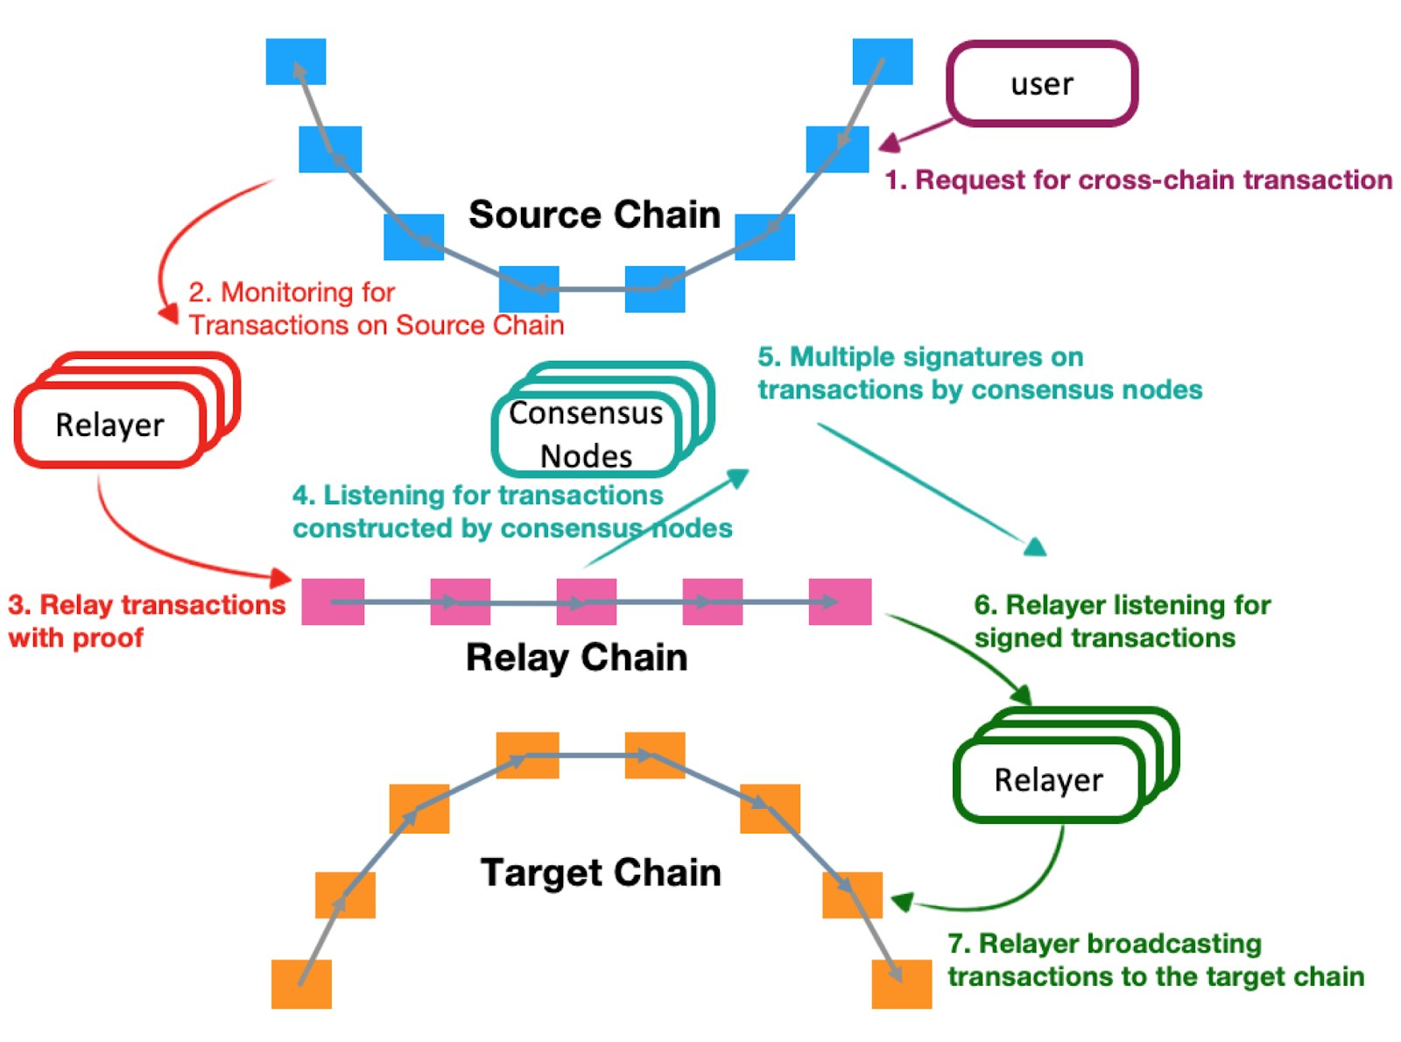
Simplified Payment Verification with Relays
Relay chain is a sidechain common to multiple blockchains
Source: https://cointelegraph.com/press-releases/an-introduction-to-the-various-types-of-cross-chain-bridge-solutions
Notes:
Here we consider simplified payment verification with a relay blockchain.
A relay chain is a sidechain common to multiple blockchains.
In the relay model, a set of relay nodes are deployed in each blockchain network (these nodes can also be part of the relay network), which is responsible for monitoring and synchronising the transaction data of that blockchain to the relay chain.
The consensus nodes of the relay chain verify the validity of cross-chain transactions and may trigger the execution of the corresponding transaction on the target chain.
The following steps are illustrated in the diagram:
A user initiates a cross-chain transaction request in the source chain (could be main chain or sidechain)
Relay nodes monitor the source chain and synchronise the transaction data to the relay chain.
The relay chain consensus node verifies the validity of the transaction, e.g., validates the block header and presence of the transaction in the Merkle tree.
The consensus node constructs the corresponding transaction.
A supermajority of consensus nodes signs the transaction, forming a signature set.
The relay nodes for the target chain monitor the transaction and signatures.
The relay node carries the transaction to the target chain and initiates relevant action(s).
Rather than establishing a relay chain, light clients in the parent chain can act as relays to the sidechain. Therefore, relays are considered a specific implementation of sidechains.
This approach is used in BTC-relay and Ethereum contract for Bitcoin SPV.
The public sidechain might not have settlement finality. Hence, finality is a problem for such blockchains.

Slide 14

Centralised 2-Way Peg
Lock main chain token TX
Unlock main chain token TX
Main chain
Exchange
Wallet on main chain
Wallet on sidechain
Sidechain
Unlock sidechain token TX
Lock sidechain token TX
Notes:
This is essentially a notary scheme where a centralised or decentralised exchange holds assets for either the main or sidechain.
Exchange enforces the promise of locking tokens on the source chain before unlocking tokens on the target chain. This is like depositing funds at Bitcoin banks such as Coinbase or Xapo. View these Bitcoin banks’ internal ledgers as sidechains to Bitcoin.

Slide 15

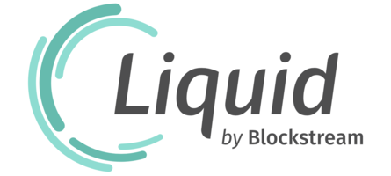
Federated 2-Way Peg
Lock main chain token TX
Unlock main chain token TX
Main chain
Exchange
sign
Notary 1
Multi-sig wallet on main chain
Multi-sig wallet on sidechain
Notary 2
sign
Sidechain
Unlock sidechain token TX
Lock sidechain token TX
Notes:
This approach tries to minimise centralisation through the exchange.
It uses a group of notaries to control the locked assets, where most have to approve to unlock the funds using a multi-signature scheme.
This setup is better than having a single controller of the funds but may still centralise control.
To achieve true decentralisation, the notaries should be carefully selected so they are located in different jurisdictions and different geographies, as well as each should have a higher reputation and better security.

Slide 16

Hash-Time Lock Contract (HTLC)
TX{transfer 1 BTC to Bob if hash(secret) = h before timeout t}
s
h = hash(s)
TX{transfer 5 ETH to Alice if hash(secret) = h before timeout t’}
Reveal secret s to claim 5 ETH
Use secret s to claim 1 BTC
Achieves TX atomicity through a hash-time lock
Alice generates a random number s, & calculates its hash h = hash(s)
Alice sends a TX to Bob, allowing him to claim BTC if he knows s
Bob sends a TX to Alice, allowing her to claim ETH if she knows s
Alice claims ETH by submitting secret s
Bob can claim BTC as s is now revealed on ledger
If Alice doesn’t present s before timeout, each party’s locked assets can be claimed
Notes:
Hash Time Lock Contract (HTLC) (aka hash lock time lock or hashed time-lock contracts) is an atomic transaction mechanism to swap assets across 2 or more blockchains.
The figures give an overview of HTLC though it can be implemented in several ways and can be extended to operate across 2+ actors.
Suppose Alice and Bob want to swap BTC and ETH at a 1:5 rate. The following steps are involved:
First, Alice generates a random number, s, and calculates its hash h = hash(s).
Alice sends a TX to Bob (how this can be done is discussed in the next set of slides), allowing him to claim Alice’s BTC if he knows s.
Bob sends a TX to Alice, allowing her to claim ETH if she knows s.
Alice claims ETH by submitting the secret to the blockchain.
Bob can claim BTC as s is now revealed on the ledger. Alternatively, Alice may send s to Bob after she gets ETH.
If Alice doesn’t present s before the timeout, each party’s locked assets can be claimed by submitting the TX.
Known examples:
Kaileido offers a simple process to swap tokens using HTLCs securely.
The Bitcoin Lightning Network supports multi-hop payment channels by linking existing payments through a chain of HTLCs. This enables parties to transact beyond their payment channel.
AirSwap supports atomic token swaps with a guaranteed price. It also supports swaps via Metamask wallet and custom swaps with parties trading tokens.

Slide 17
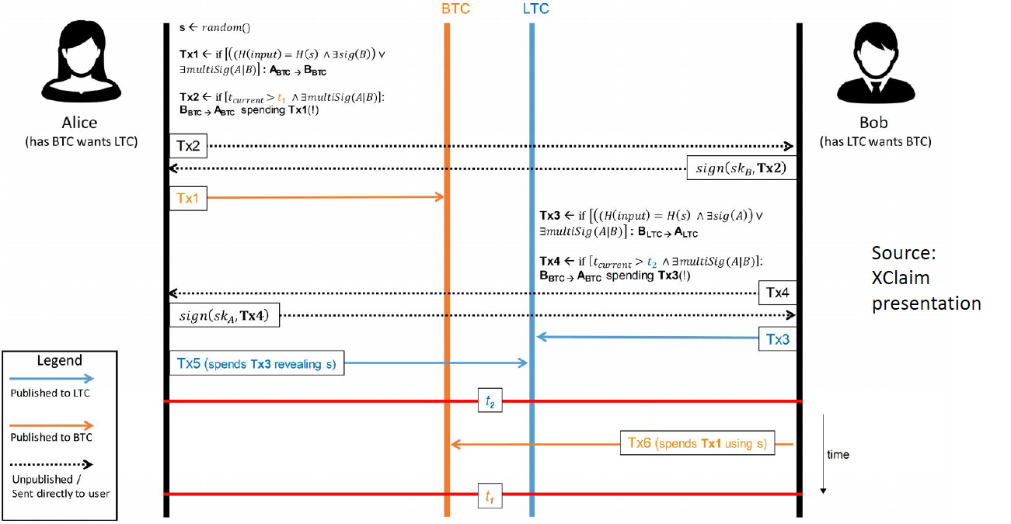
HTLC Using TXs
Notes:
Here’s an HTLC implementation using only transactions. It swaps BTC with LTC (Litecoin).
For this to work, transactions should have scripting functionality or simple logic checks like in Bitcoin.
First, Alice generates a random number s, and calculates its hash h = hash(s).
Alice generates and sends TX1 to the Bitcoin blockchain, allowing Bob to claim Alice’s BTC if he knows s.
Alice also generates TX2, which checks for the timeout. If timeout, it returns Alice’s BTC to her, consuming TX1.
Bob confirms TX2 by signing it as TX2 require signatures from both parties in case the secret is not revealed.
Then Bob sends TX3 to the Litecoin network, allowing Alice to claim LTC if she knows s.
Bob also generates TX4, which checks for the timeout. If timeout, it returns Bob’s LTC to him, consuming TX3.
Alice confirms TX4 by signing it.
Alice claims LTC by submitting secrets to the blockchain via TX5.
Bob can claim BTC as s is now revealed on the ledger.
If Alice doesn’t present s before timeout, each party’s locked assets can be claimed by submitting TX2 and TX4, respectively.
Bob risks not submitting the secret before timeout if Alice submits the secret only last minute.

Slide 18
Blockchain of Blockchains
Blockchain interconnecting other blockchains
Consensus protocol organises blocks containing a set of cross-chain TXs
Provides accountability for parties issuing TXs on different blockchains
Provides a holistic view of each underlying blockchain
Focus on data & digital assets
Mostly based on hub & spoke model
Examples
Cosmos
Polkadot
Cardano
Notes:
Blockchain of blockchains (aka internet of blockchains) is an interoperability approach where a blockchain interconnects with other blockchains.
Consensus protocol in the interconnecting blockchain organises blocks containing a set of cross-chain TXs.
It provides accountability for parties issuing transactions on different blockchains.
Provides a holistic view of each underlying blockchain.
Most of the interoperability solutions discussed so far had a digital asset focus (mainly crypto). Whereas these solutions are more general but extremely complex to build.
Most implementations are based on some form of hub and spoke model, where the hub interconnects other blockchains rather than establishing many connection pairs between blockchains.
Some of the popular examples include Cosmos, Polkadot, and Cardano.

Slide 19
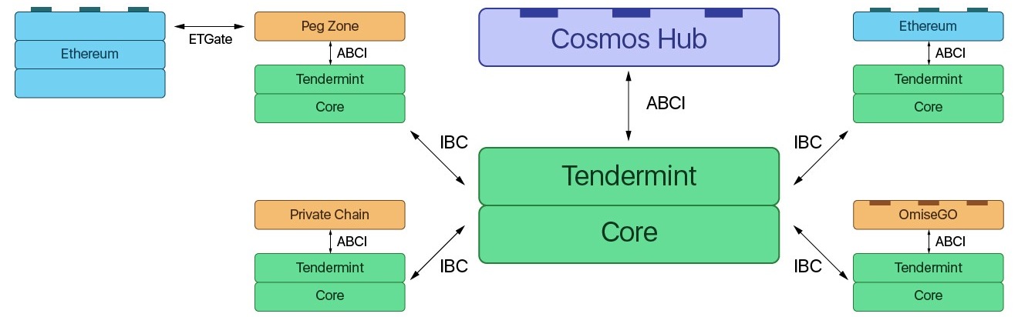
Cosmos
Source: https://medium.com/@davekaj/blockchain-interoperability-cosmos-vs-polkadot-48097d54d2e2
Cosmos Hub is a PoS blockchain
Inter Blockchain Communication (IBC) protocol connects blockchains through Cosmos Hub
IBC passes certificates about TXs or ledger states
Application Blockchain Interface (ABCI) connects Tendermint replication engine & ledger
Peg zones are like pegged sidechains
Notes:
Cosmos Hub is the main blockchain that acts as a central connector for all of the blockchains in the Cosmos Network. It is a multi-asset, proof-of-stake blockchain powered by Tendermint.
Tendermint is a Practical Byzantine-Fault Tolerant (PBFT) state machine, along with a peer-to-peer network gossiping protocol.
Inter Blockchain Communication (IBC) protocol allows blockchains to interact with others through Cosmos Hub by creating certificates about transactions or ledger states.
Blockchains are connected in a hub and spoke model to the Cosmos Hub. The spokes of the network are called zones.
Application Blockchain Interface (ABCI) defines the boundary between the Tendermint replication engine and the ledger. The ABCI is the only way for the blockchains state to be updated, and only Tendermint has access to state-changing functions for the blockchain.
Peg zones resemble the pegged sidechain mechanism.
To do this we need to have a shared security model where the Cosmos Peg Zone Validator is also running an Ethereum node. The special Validator approves the interactions between the 2 chains. This is a complicated infrastructure to set up, and you must trust the team running the Peg Zone.
The actual exchange of assets would require an Ethereum smart contract to lock in Ether, which would create new tokens in the Peg Zone that represent “Cosmos-Ether” that can be sent around the Cosmos Network through IBC. On the Cosmos side, the Validator would lock up Atoms (native cryptocurrency in Cosmos), which would, in turn, create an ERC-20 Atom token that can be sent around Ethereum.

Slide 20
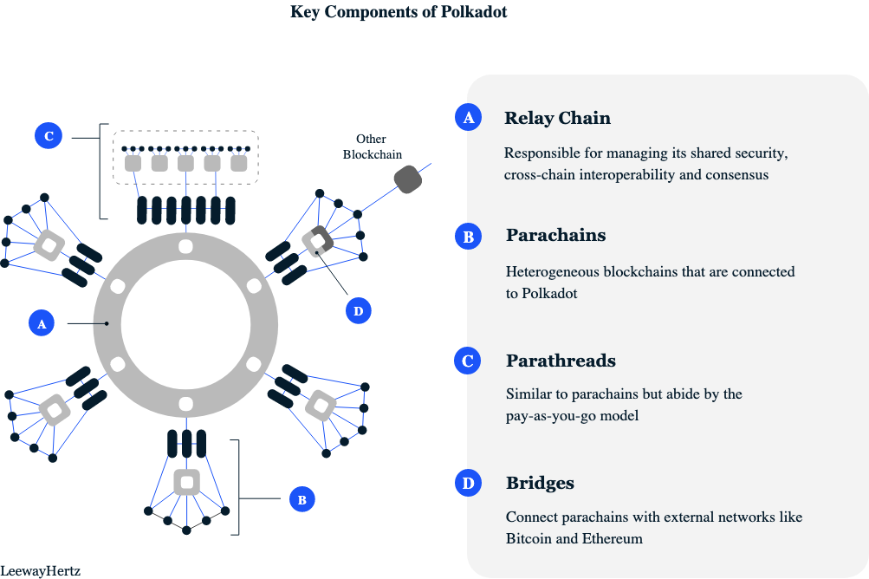
Polkadot
PoS blockchain
Relay chain – core that manages cross-chain interoperability & consensus
Parachains – heterogeneous blockchains connected to Polkadot
Parathreads – similar to parachains but based on pay-as-you-go model
Bridges – allow connection with external networks
Collators – produce valid parachain blocks
Validators – responsible for proposing a parachain block to relay chain
F
E
Notes:
Polkadot is a PoS blockchain that runs a set of shards and can connect to other blockchains. It supports cross-chain computation and cross-chain registries.
It has a large set of roles/nodes, and key ones are illustrated in the figure.
The relay chain is the core of the Polkadot network. It manages shard security, cross-chain interoperability, and consensus.
Parachains refer to all the heterogeneous blockchains that are connected to Polkadot. Parachains can have their tokens, specific functionalities, use cases, and governance.
Parathreads are also similar to Parachains but abide by the pay-as-you-go model (i.e., they connect when they want). These are the chains that don’t require continuous connectivity to the network.
Bridges allow Parathreads and Parachains to connect and interact with external networks like Bitcoin and Ethereum.
Collators produce blocks within a Parachain.
Validators are responsible for proposing a Parachain block to relay chain.
Each Parachain relies on a central shard within the ecosystem for cross-chain communication and security.

Slide 21
Layer 2 Mechanisms

Slide 22
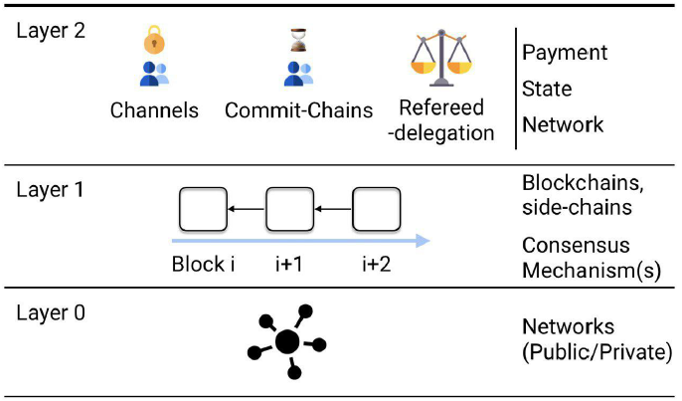
Layer 2
Layer 0 – Main/base blockchain
Layer 1 – Sidechains
Change in base protocol, e.g., low difficulty, PoW to PoS/PoA, large block size, & sharding
Layer 2 – Services built on Layer 1
Process & record TXs off-chain
Tethered/pegged to a sidechain
E.g., payment channels, rollups, plasma
Enhanced scalability, performance, & lower cost
Source: L. Gudgeon et al., “Sok: Layer-two blockchain protocols”, Int. Conf. on Financial Cryptography and Data Security, Feb. 2020.
Notes:
Sidechains are considered layer 1 solutions (built on top of layer-0 solutions which is the main blockchain) to implement layer-2 solutions, such as payment channels.
Sidechains typically run the same blockchain with a few changes to the base protocol like low difficulty, PoW to PoS/PoA, large block size, and sharding.
There’s no clear agreement on Layer 0 and 1, note that the figure and bullet points are a bit different. But there seems to be agreement on Layer 2.
The second layer allows off-chain transactions between users through exchanging messages tethered/pegged to a sidechain.
Sometimes, Layer 0 is also called Layer 1, and sidechains are considered as Layer 2.
Key benefits of Layer 2 solutions include enhanced scalability (i.e., handling more transactions), performance (i.e., low latency), and lower cost
Next, we discuss a couple of Layer 2 solutions.

Slide 23
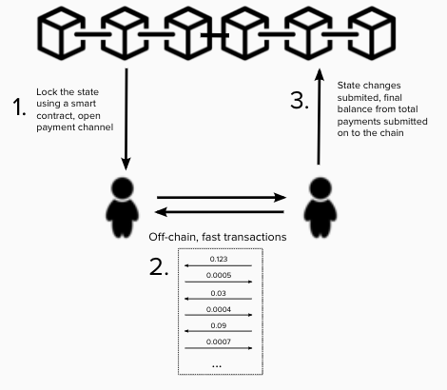
State Channels (aka Payment Channels)
Public blockchains aren’t attractive for micropayments
TX fee >> monetary value of micropayment TX
Long TX commit time
State channels process & record TXs off-chain & eventually settle on-chain
Lock away assets on-chain (1 or both slides)
Transact off-chain while maintaining intermediate states on payment channel
Update/settle on-chain
Frequency of settlement depends on use cases
Source: https://www.nichanank.com/blog/2018/9/27/scalability-pt-2-state-channels-counterfactual-instantiation
Notes:
Micro-payments TXs are too expensive to be performed on-chain because the TX fee might be higher than the monetary value associated with the TX (assuming a public blockchain is used). Also, the main chain’s TX commit time (including finality) could be too high.
Therefore, it makes sense to perform micropayments off-chain, given their relatively low risk.
As seen in the figure, payment channels process and record TXs off-chain and eventually settle on-chain.
First, one or both parties lock assets (e.g., ETH) on the main chain’s smart contract. Typically, this contract uses multi-signature.
Then they establish a channel for payment between the 2 parties.
Then based on the locked asset value, 2 parties transact off-chain while maintaining intermediate states on the payment channel, i.e., keep a record of TXs and balances. Ideally, each TX is signed by all parties involved in the channel.
On-chain balance could be updated periodically or when closing the payment channel to settle the balance. The frequency of settlement depends on the use case.
When closing a channel, if both parties unanimously approve the last state, the channel is settled immediately. Even a single party can request to close a channel (the other party is no longer contactable). However, in such cases, there’s a time window that allows a missing party to prove a more recent state (each TX has a nonce or a sequence no) if he/she doesn’t agree with the currently submitted final state.
Such a payment channel can be generalised for arbitrary state updates for more general purposes than monetary values. Such channels are known as “state channels”
See State Channels | ethereum.org

Slide 24
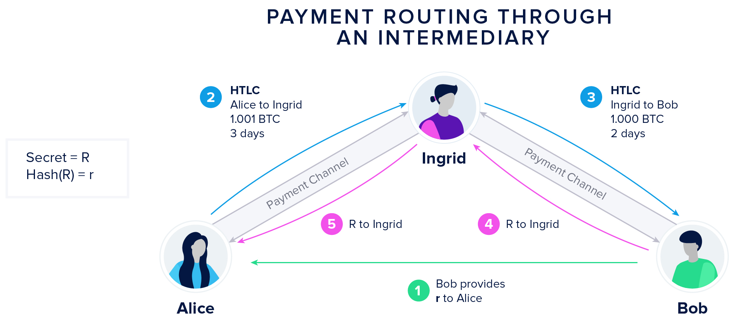
Payment Routing via State Channels
Source: https://www.horizen.io/blockchain-academy/technology/expert/state-and-payment-channels/
Notes:
A set of payment channels between 2 parties can be used to route payments between parties that don’t have a payment channel.
In the figure, Alice and Bob don’t have a payment channel. However, Alice and Bob have a payment channel with Ingrid.
Here we illustrate how 2 HTLCs (Hash-Time Lock Contracts) can be used to transfer payment from Alice to Bob.
Bob creates the secret R and shares its hash r with Alice.
Subject to this hash, Alice creates an HTLC indicating the amount to transfer to Ingrid if she knows the secret. It also indicates a timeout of 3 days.
Subsequently, Ingrid establishes an HTLC indicating the amount to transfer to Bob if he knows the secret. It also indicates a timeout of 2 days.
The difference in value between 2 HTLCs will be given as payment for Ingrid’s service to route the payment (i.e., Ingrid will receive 1.001 – 1 = 0.001 BTC).
Timing is also important, as once Bob gets BTC from Ingrid, she needs to have sufficient time to claim payment from Alice.
Finally, Bob relevels the secret R to the 2nd HTLC to receive the payment.
As the secret is revealed, Ingrid can submit R to 1st HTLC to get BTC from Alice.
This idea can be extended beyond parties that are 2-hops away from each other into multiple hops. Routing algorithms can be used to find a path between 2 parties that wish to transact and then a chain of HTLC contracts can be established with appropriate payment values and timeouts

Slide 25
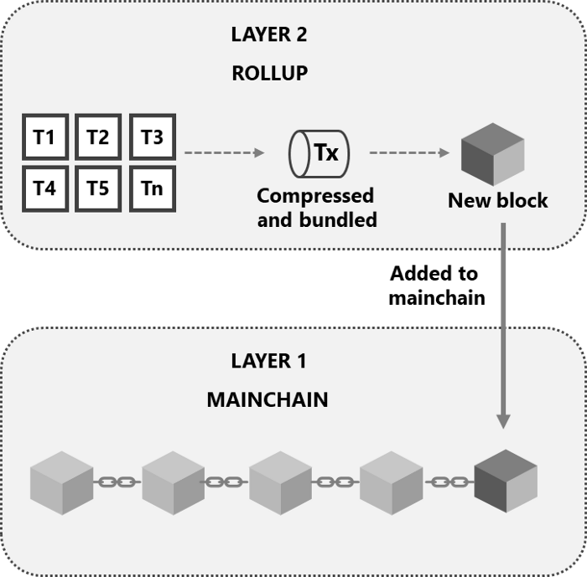
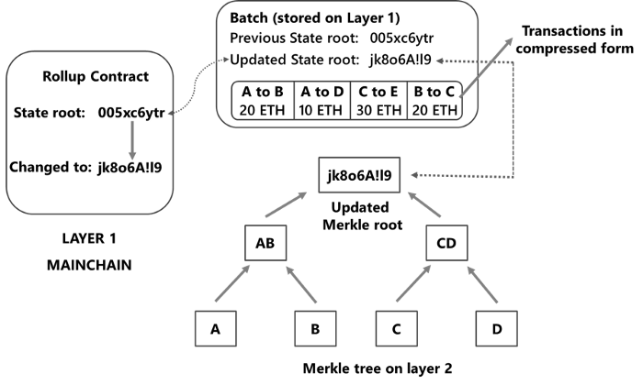
Rollups
Layer 2 runs an EVM, but no block building
Deploy “rollup contract” on main chain that stores state root of rollup layer
Lock main chain assets in a smart contract
TXs at rollup layer use locked in asset value
Record Merkle tree root of state & compressed TX data on rollup contract
Use “fraud proofs” to challenge state root
If state update is proven to be invalid, roll back batch of TXs
Source: https://medium.com/techskill-brew/layer-2-blockchain-scaling-solutions-channels-sidechains-rollups-and-plasma-part-16-79819e058ef6
Notes:
Rollups usually involve only 2 layers. Hence, sometimes the main chain is considered Layer 1.
Layer 2 runs a smart contract execution engine like EVM. However, Layer 2 does not build blocks.
Multiple validators may run this EVM and double-check each other’s work. If only a single validator is used (i.e., centralised) it’s called a sequencer.
First, a party providing rollup service deploys the “rollup contract” onto the main chain that stores the state root of the rollup layer.
Any party that wishes to use the rollup service locks main chain assets in a smart contract, e.g., ETH, ERC-20 tokens, or any other accepted asset.
Transactions at the rollup layer can use the locked-in asset value, i.e., the asset is minted on the rollup layer.
The rollup layer executes transactions and keeps track of the state changes. Transaction fees need to be paid, but much lower than a typical transaction in Ethereum.
The rollup layer then calculates the Merkel tree root of all states.
The Merkle tree root of state and compressed transaction data is recorded on the rollup contract on the main chain. This is called a batch update.
Use “fraud proofs” to challenge state root within a given time limit from the time batch gets included in the rollup contract.
Fraud proof tries to prove an asset was double spent or sent beyond its value.
If the state update is proven to be invalid, roll back the batch of transactions by essentially replacing the current state root in the rollup contract with the previous state root.
There are 2 rollup techniques:
Optimistic rollups – See Optimistic Rollups | ethereum.org
Assume transactions are valid by default and rely on fraud proof to challenge within a specified time window. The sequencer/validator responsible for including the incorrectly executed transaction in a block receives a penalty (the validator keeps a bond like in PoS). Party of the penalty is provided to the challenger and the rest is burned.
There are several ways to check a fraud-proof on-chain. See Optimistic Rollups | ethereum.org for 2 such mechanisms
Can offer up to 10-100x improvements in scalability
Write TXs to Ethereum as call data, reducing gas costs for users. This includes the Merkel root of the ledger state (state root) and a batch of transactions (transaction root)
Zero-knowledge rollups – See Zero-Knowledge rollups | ethereum.org
Perform computation off-chain and submit only a validity proof – a validity proof demonstrates with cryptographic certainty that the proposed changes to the ledger state are truly the result of executing all the transactions in the batch. Validity proof is shorter than compressed transactions stored in optimistic rollups.
SNARKs or STARKs algorithms are typically used to generate validity proof. These require specialised hardware and more on-chain computation; hence, increasing transaction fees.
A major limitation of optimistic rollups is the longer withdrawal time. If anyone suspects a transaction to be fraudulent, they can challenge it and submit fraud proof within the time duration of 7 days. Thus, users have to wait around one week to withdraw their assets from layer 2 rollups.
These techniques drastically improve throughput, but not latency and finality.

Slide 26
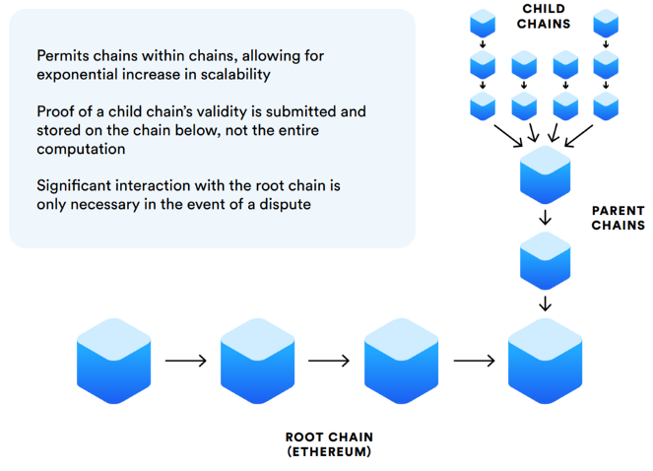
Plasma
A hierarchy of blockchains
Child chains use simplified consensus process & has high performance
Lock root chain assets in a smart contract
Issue assets on a child chain
TXs at child chain use those assets
Store Merkle tree proof of a child chain’s validity on chain below
Root chain is involved only in resolving disputes
Use “fraud proofs” to challenge Merkel tree proofs
If TX is proven to be invalid, unlock assets on root chain
Source: https://medium.com/@marcocavicchioli/plasma-cash-new-scalability-solution-for-the-ethereum-network-f7c0b889db7d
Notes:
Plasma is a high-level specification with several proposal implantations, e.g., Plasma Cash.
As seen in the figure, plasma establishes a hierarchy of blockchains where child chains anchor on to parent chain, and patent chain anchor onto the root chain (aka the main chain).
Child chains typically use simplified consensus processes (e.g., lower difficulty, PoS, or PoA) and have high performance.
To use a child chain uses lock root chain assets in a smart contract at the root chain.
Based on the locked, Issue assets on the chosen child chain.
Then the user can transact at the child chain using those assets.
Store Merkle tree proof of a child chain transactions to prove the validity of the chain below. The parent chain then stores its Merkle tree proof on the chain below.
The root chain is involved only in resolving disputes.
Similar to rollups, users can use “fraud proofs” to challenge Merkel tree proofs of child chains or any chain above.
If a transaction is proven to be invalid, assets locked on the root chain can be released.

